Slide 1
The Nervous System
Anatomy of the Spinal Cord

Slide 2
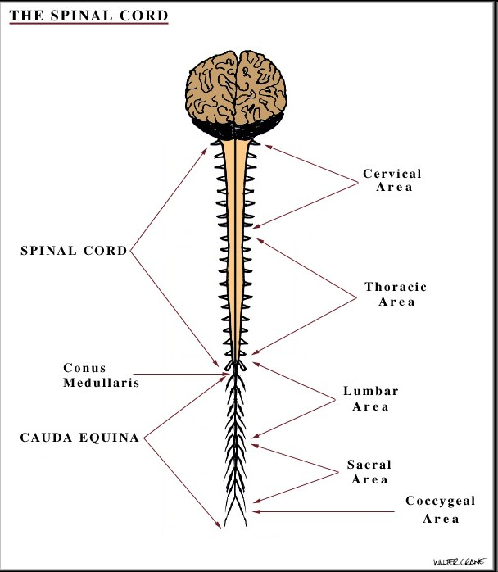
The Spinal Nerves
We have 31 spinal nerves that branch off the spinal cord
8 cervical
12 thoracic
5 lumbar
5 sacral
1 coccygeal

Slide 3
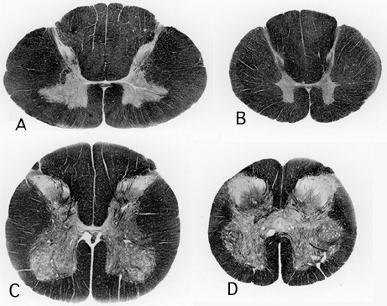
Spinal Cord Segments
A – Cervical
B – Thoracic
C – Lumbar
D - Sacral

Slide 4
Spinal Cord Segments
A – Cervical
B – Thoracic
C – Lumbar
D - Sacral
Cross sections are larger due to increased number of neural circuitry related to the limbs

Slide 5
Spinal Cord Segments
A – Cervical
B – Thoracic
C – Lumbar
D - Sacral
Greater number of tracts traveling up and down, fewer connections.

Slide 6
Spinal Cord Segments
A – Cervical
B – Thoracic
C – Lumbar
D - Sacral
Fewer tracts, more connections.

Slide 7
Spinal Cord Segments
A – Cervical
B – Thoracic
C – Lumbar
D - Sacral

Slide 8
Types of Tracts
Ascending Spinal Tracts
Periphery to spinal cord and brain
Descending Spinal Tracts
Cortex to periphery and exterior levels

Slide 9
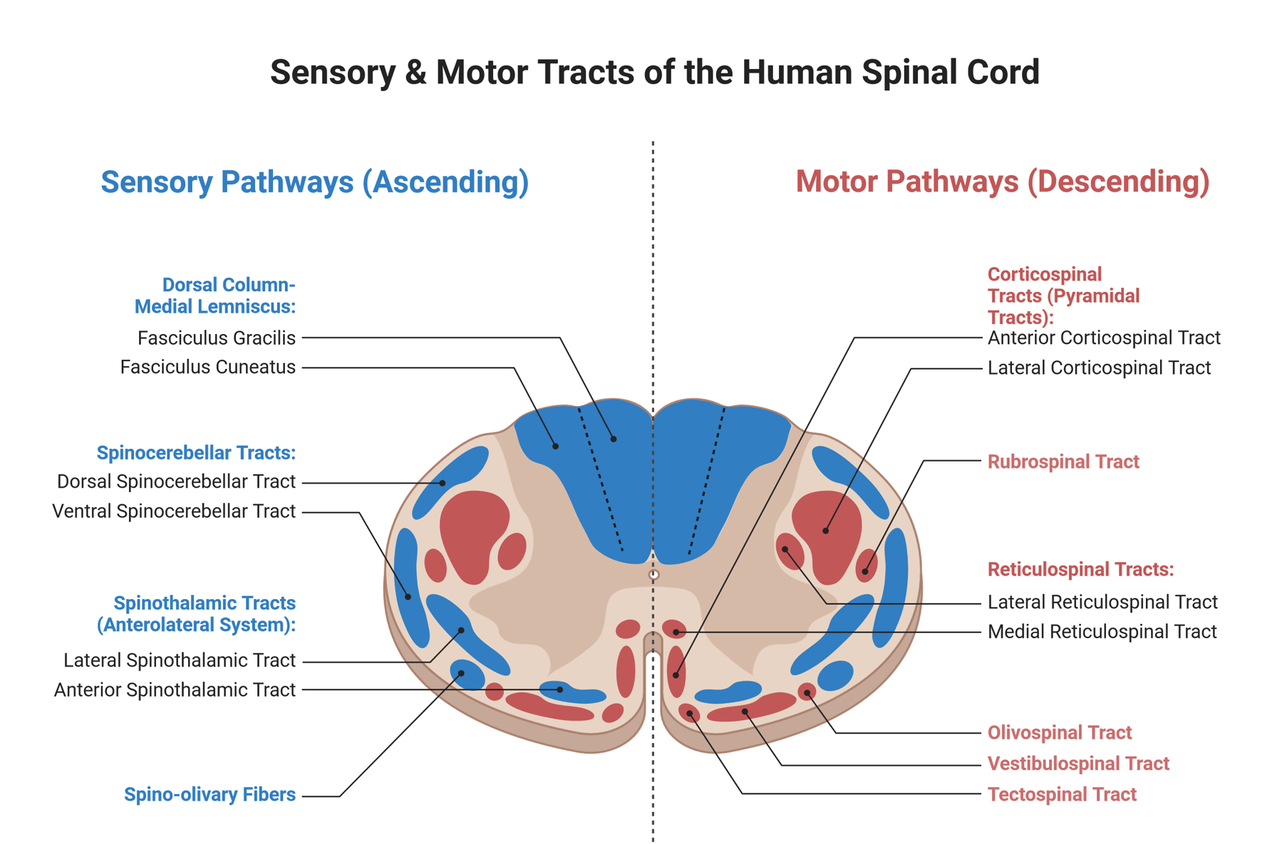

Slide 10
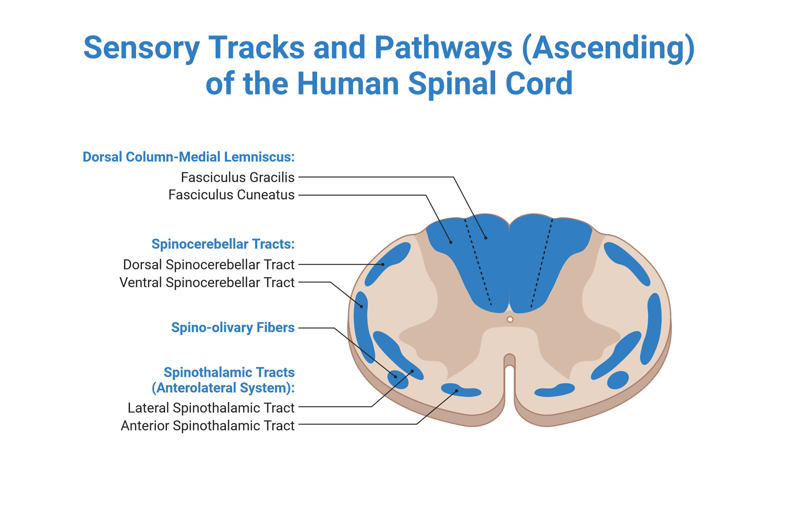

Slide 11
Ascending Tracts: Dorsal Column/ Medial Lemniscus
Carries information for fine touch, vibration and proprioception

Slide 12
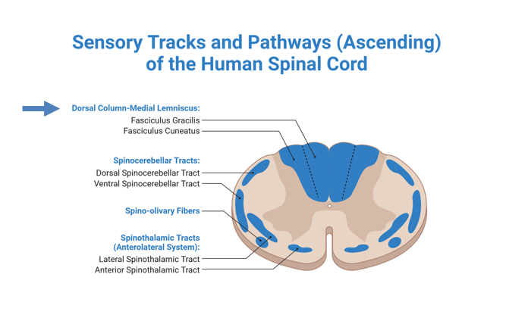
Ascending Tracts: Dorsal Column/ Medial Lemniscus
  Fasciculus gracilis : Lower limb sensations
  Fasciculus cuneatus: Upper limb, trunk, neck sensations (only T6 an up)

Slide 13
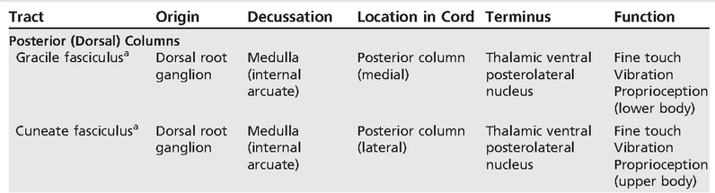

Slide 14
Ascending Tracts: Spinocerebellar
Conveys unconscious proprioceptive information from the body to the cerebellum.

Slide 15
Ascending Tracts: Spinocerebellar
  Dorsal (posterior): fine coordination of posture and movement of individual muscles
  Ventral (anterior): impulses from lower extremity

Slide 16
Ascending Tracts: Spinothalamic (Anterolateral System)
Lateral Spinothalamic: Pain and temperature
  Injury affects the opposite side of the body one spinal cord segment below lesion
    Contralateral
Anterior Spinothalamic: Light Touch
  Injury produces little disturbance

Slide 17
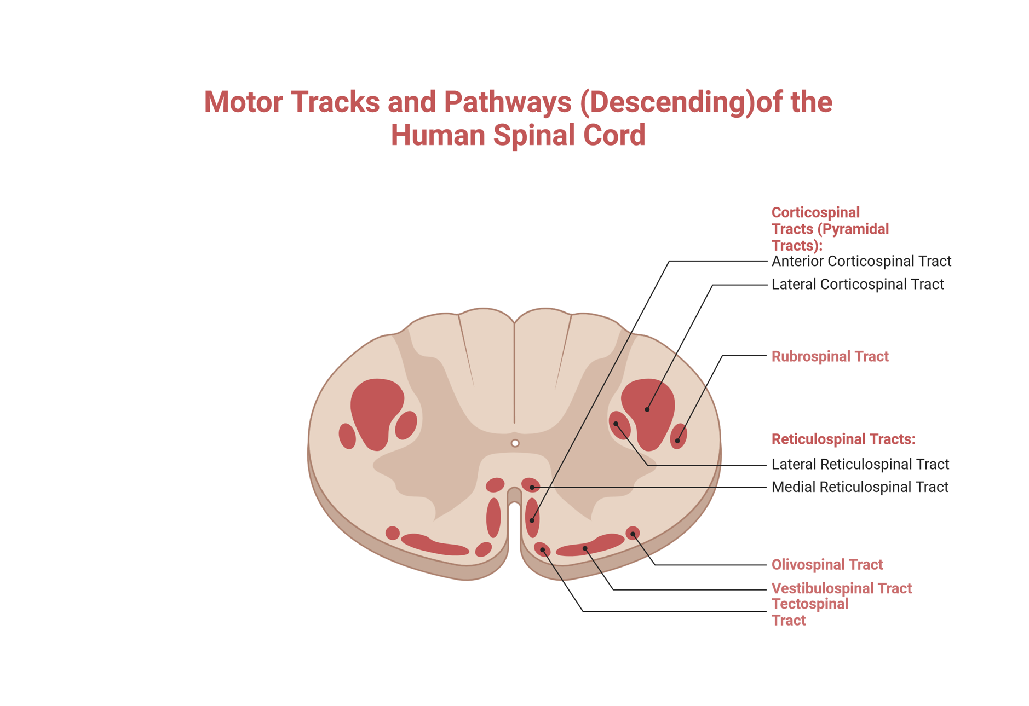
Pontine Reticulospinal= Medial reticulospinal tract
Medullary Reticulospinal= Lateral reticulospinal tract

Slide 18
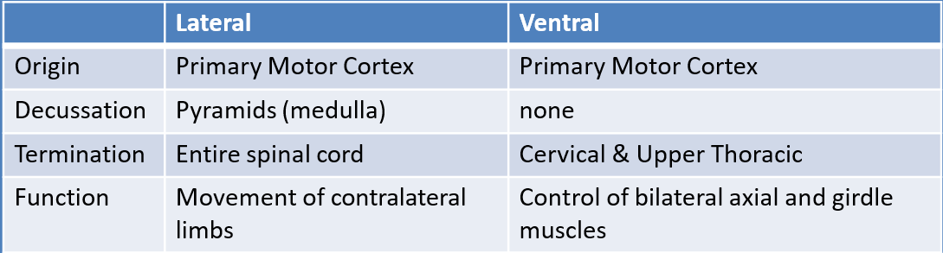
Corticospinal Tracts
  Voluntary, skilled movement
  Decussation at pyramids (medulla)
    80-85 percent cross-over

Slide 19
Activity
  Which tract decussates at the pyramids (medulla)?

Slide 20
Other Motor Tracts
 | Rubrospinal | Lateral Vestibulospinal | Medial Vestibulospinal | Pontine Reticulospinal | Medullary Reticulospinal
Origin | Red nucleus (midbrain) | Vestibular nuclei | Vestibular nuclei | Reticular formation | Reticular formation
Decussation | Ventral tegmentum (midbrain) | None | None | None | None
Termination | Cervical cord | Entire cord | Cervical & Upper Thoracic | Entire cord | Entire cord
Function | Muscle tone | Maintaining balance | positioning of head and neck | Automatic posture and gait- related | Automatic posture and gait-related
 |  |  |  | movements ; axial and limb muscles | movements

Slide 21
Weakness is named after location and severity of deficit
Next Week:
Quiz 5

